Slide 1
Deep Learning in Computer Vision (Part-2)
Convolutional Neural Networks (2D and 3D)
Computer Vision, 6th Semester, 2024

Slide 2
About Convolutional Neural Networks
Specialized type of neural network designed primarily for processing grid-like data such as images and videos.
Built upon the concept of convolution (weighted summation of pixels in a window).
CNNs utilize layers of filters to extract local features as ‘maps’ from the input data, capturing hierarchical patterns and structures.
The architecture typically consists of alternating convolutional and pooling layers to progressively reduce spatial dimensions and increase the depth of feature maps.
Activation functions like ReLU introduce non-linearity, while techniques such as dropout and batch normalization help prevent overfitting and stabilize training.
Applications: image classification, object detection, and image segmentation, achieving state-of-the-art performance across various applications.

Slide 3
2D (basic) Convolutional Neural Networks

Slide 4
Convolutional Neural Networks in 1D, 2D, 3D
1D-CNN: suitable for sequential data like time series or audio signals
2D-CNN: tailored for grid-like data with spatial hierarchies, such as height x width images with multiple channels
3D-CNN: built for higher-dimensional data, like videos or volumetric images

Slide 5
Basic Components of 2D-CNN
Convolutional Layer:
A filter (or kernel) slides over the input image to extract local features
Captures spatial patterns like edges, textures, and shapes
Pooling Layer:
Down-samples the spatial dimensions of the feature map
Used for reducing computational complexity and focusing on the most relevant features
Activation Function:
Introduces non-linearity to handle complex relationships within the data
Fully Connected Layer:
High-level features after multiple convolutions and poolings are flattened and passed to one or more fully connected (dense) layers for classification, regression, or further processing.

Slide 6
Other Components
Dropout layer:
regularization technique that randomly deactivates a fraction of neurons during training
prevent overfitting, improve network robustness, and enhance generalization ability
Batch normalization layer:
normalizes the activations of the neurons within a mini-batch
adjusting and scaling the activations to have zero mean and unit variance
improving the training stability, convergence speed, and generalization ability

Slide 7
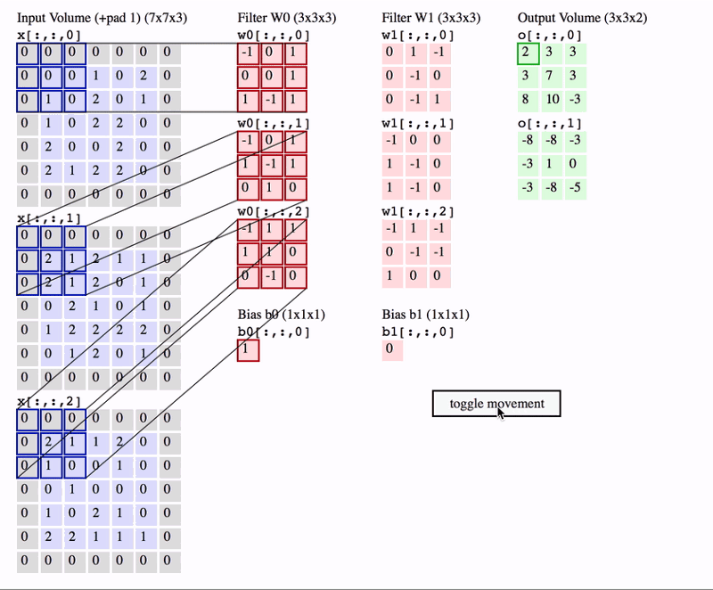
Convolutional Layer
Filters/kernels are utilized to provide weighted sums of pixel windows, thereby summarizing a feature value from a set of pixels/input data.

Slide 8

Convolutional layer in RGB channels

Slide 9
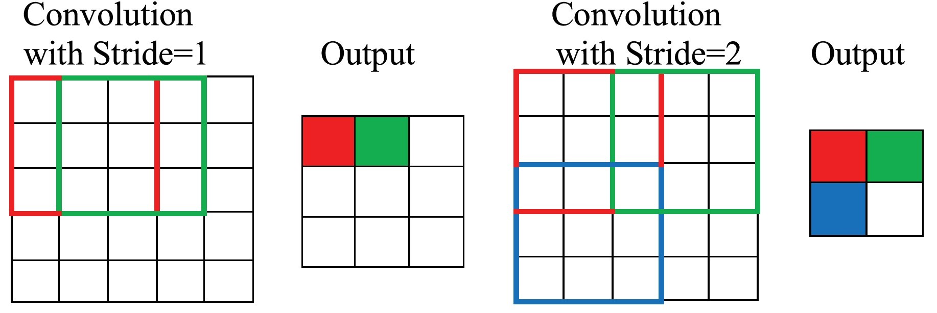
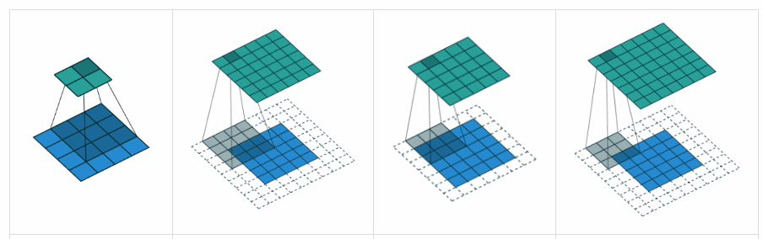
Stride and Padding
Stride:
The number of pixels that the convolution window moves after every convolution operation
Padding:
Extra pixel rows/columns added to the edges of the input map so as to permit convolution on the edge and corner values

Slide 10
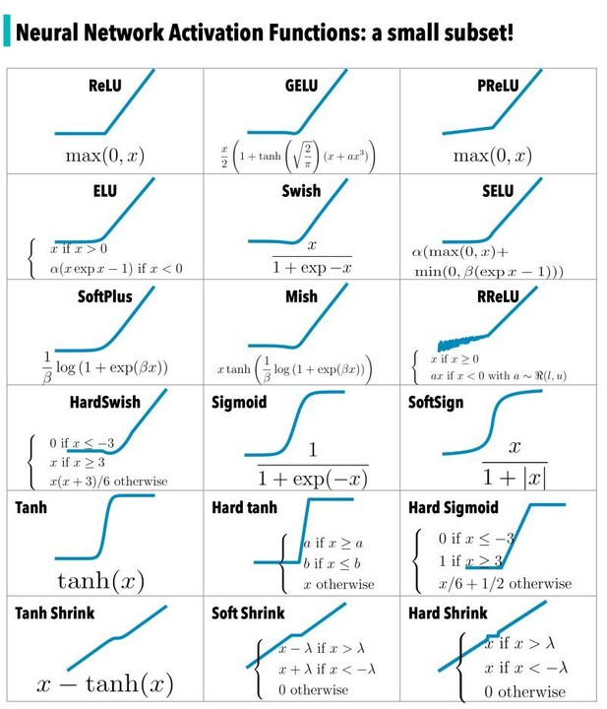
Activation Functions
Adding non-linearity to the network to learn complex patterns and relationships in the data

Slide 11
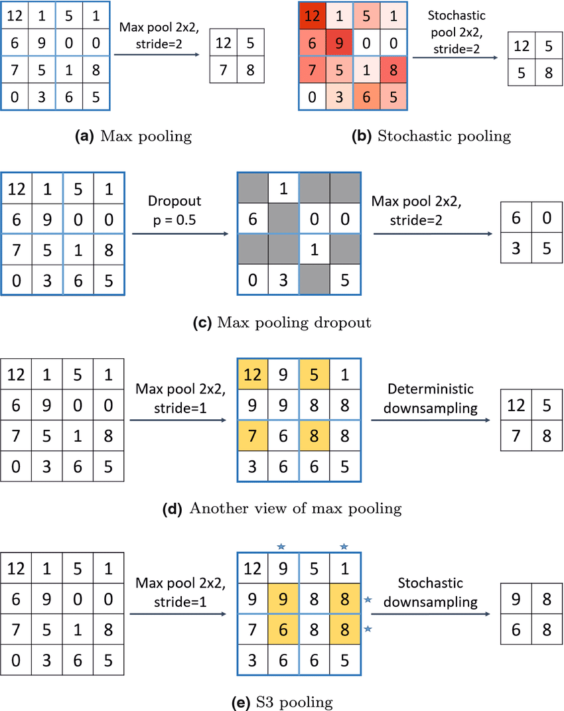
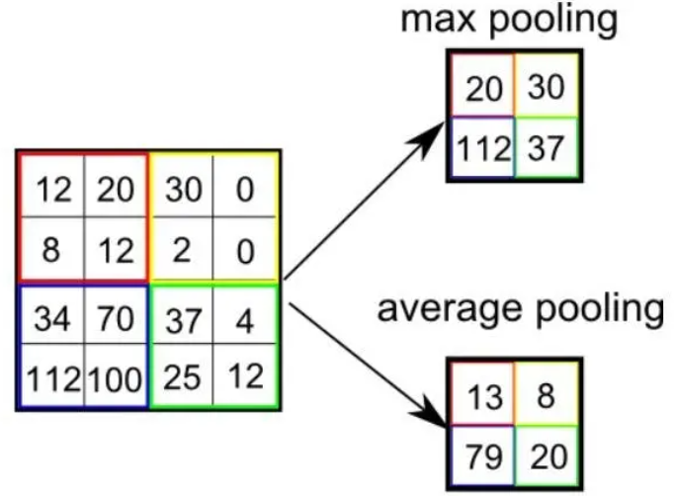
Pooling Layer
Summarises the values in a given window, in order to reduce the features without losing much detail
Improves computational efficiency
Types of pooling:
Max
Average
Global
Stochastic, etc.

Slide 12
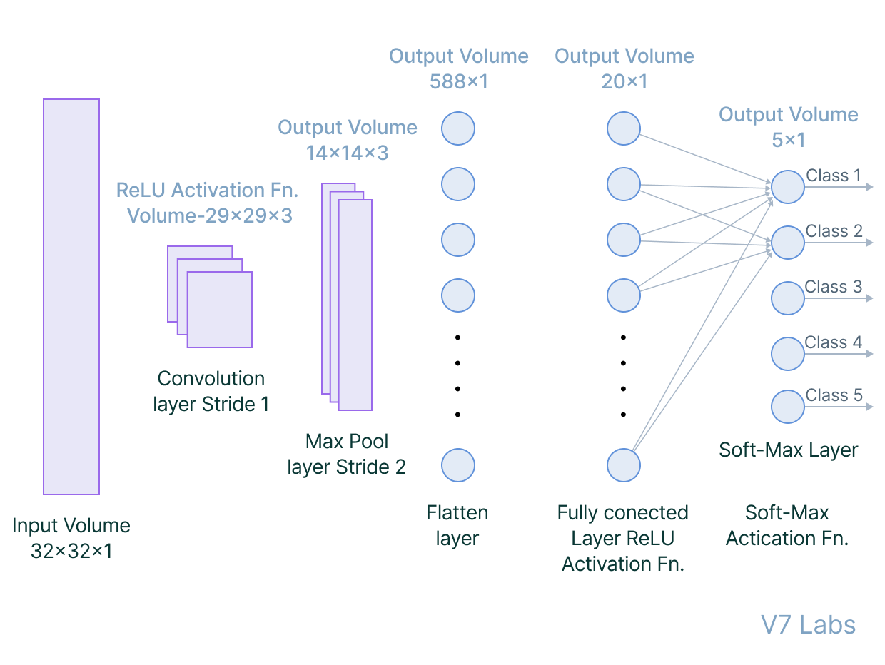
Fully Connected Layer
Simple neural network used for tasks such as classification or regression.
Set of layers of neurons that take flattened feature vector from the final pooling layer as input and produce a categorical or probabilistic output

Slide 13
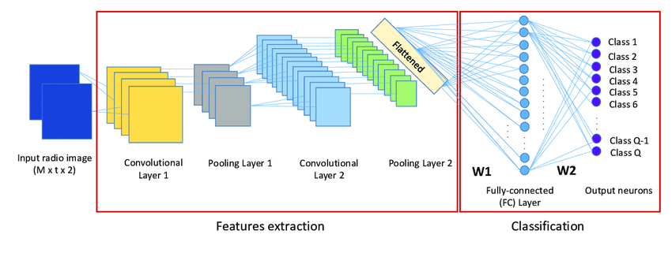
CNN Examples – Radio Image Classification

Slide 14
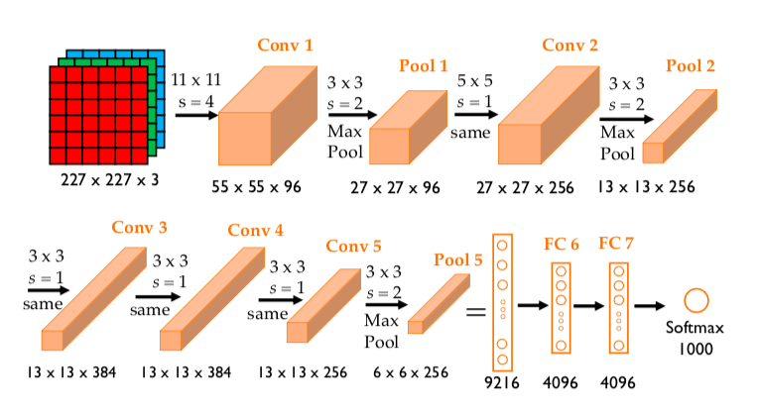
CNN Examples - AlexNet

Slide 15
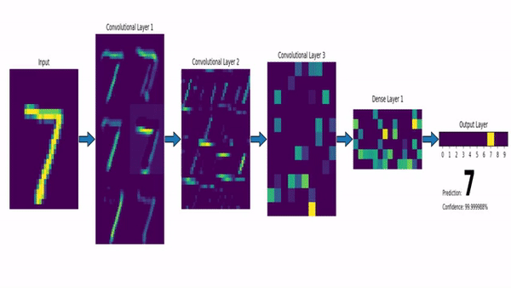
CNN Examples – Number classification

Slide 16
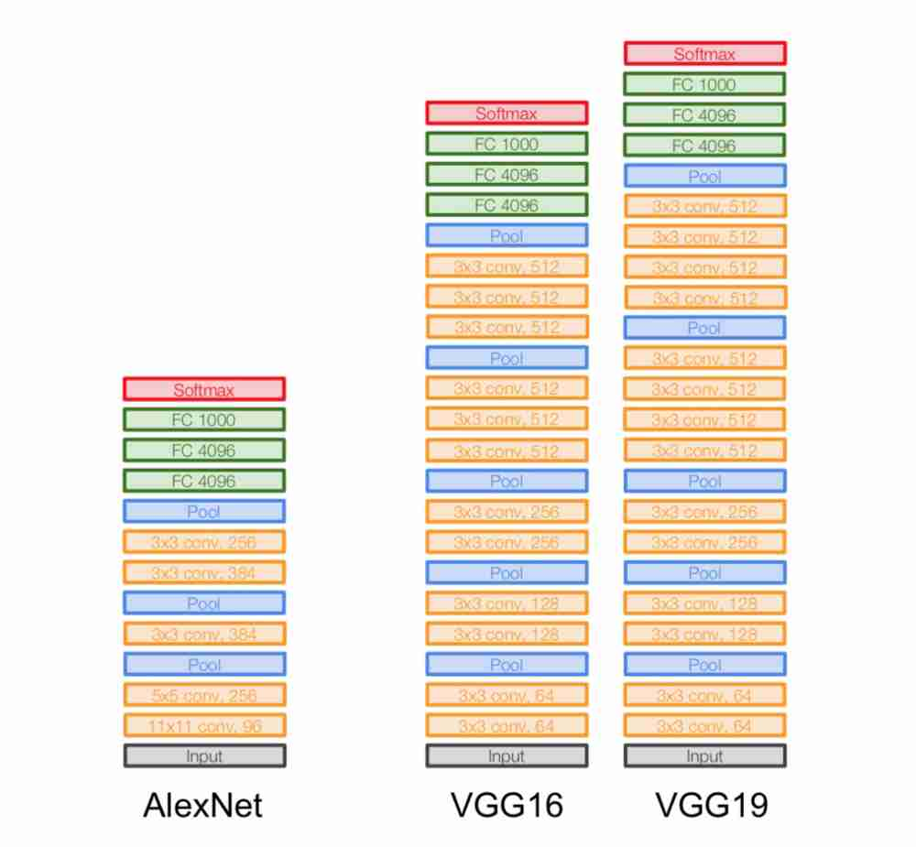
VGG (Visual Geometry Group) CNN
Simplest CNN models along with AlexNet, LeNet, and GoogleNet
Popular variants:
VGG-16
VGG-19

Slide 17
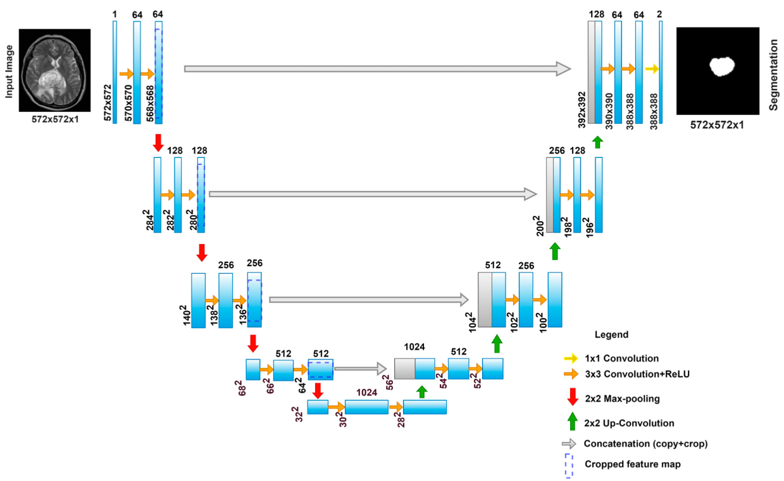
U-Net: CNN with Deconvolution and Skip Connections
designed for biomedical image segmentation tasks
characterized by its U-shaped structure:
encoder (contracting path, convolutions and pooling/down-sampling)
decoder (expanding path, deconvolutions and un-pooling/up-sampling)
bottleneck layer between encoder and decoder

Slide 18
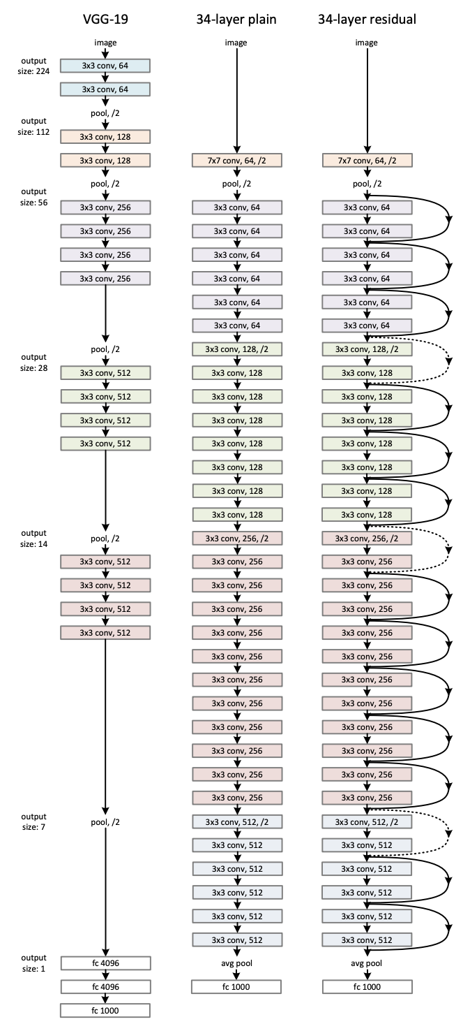
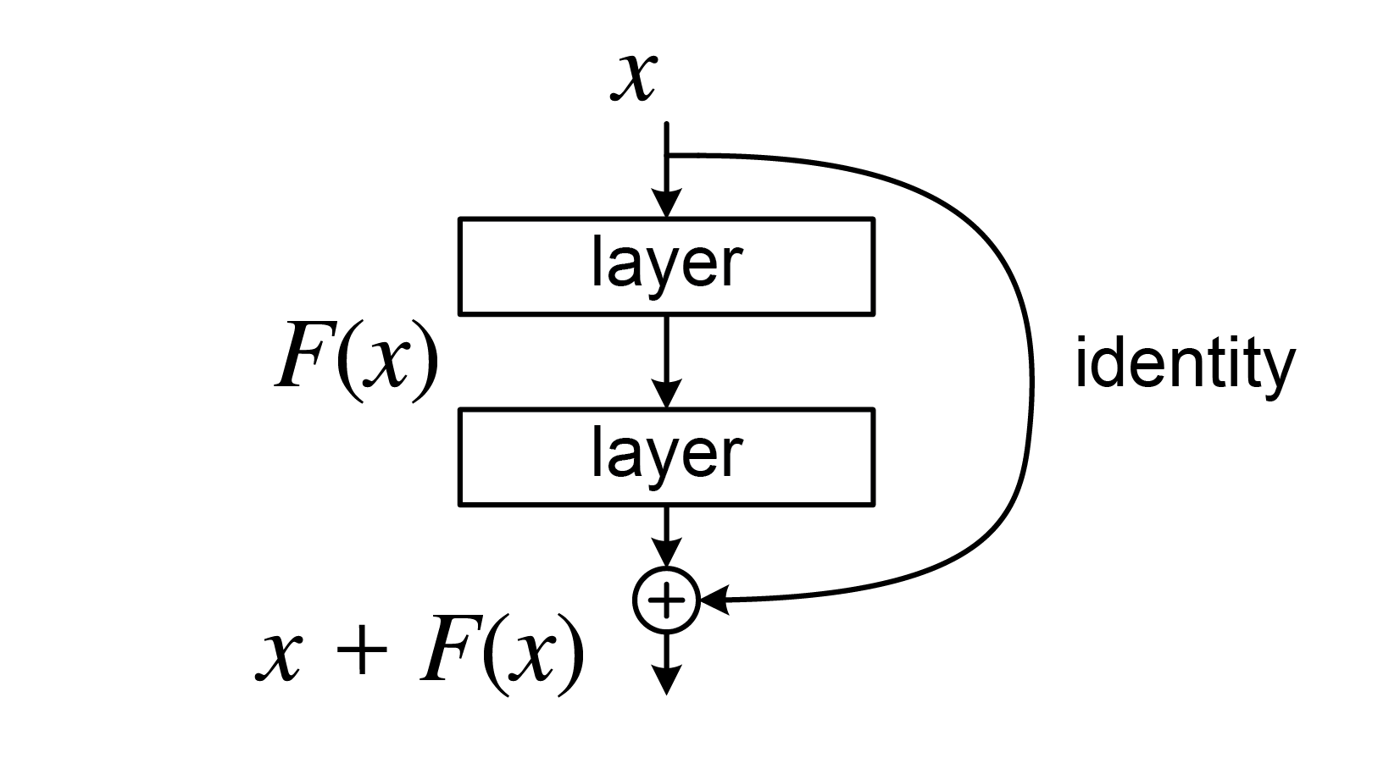
ResNet (Residual Connection) CNN
CNNs with connection of prior inputs skipping over the layers to add to convolutional outputs of the same input
Designed to address the vanishing gradient problem and enable the training of very deep neural networks
Skip/Residual connections allow the activation to bypass one or more layers to directly feed into deeper layers.

Slide 19
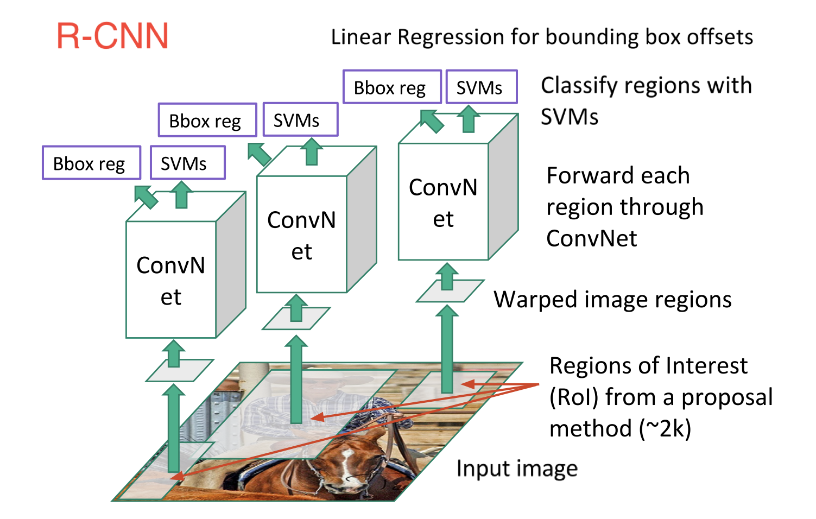
Region-CNN (R-CNN)
Used for segmentation tasks
Utilizes windows called “Region Proposals” to uniquely classify regions in the input image and thereby segment the image

Slide 20
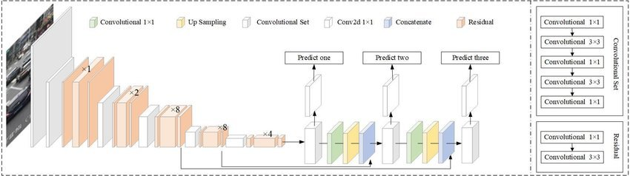
YOLO (You Only Look Once)
real-time object detection system
single neural network that divides the input image into a grid and predicts bounding boxes and class probabilities for each grid cell
convolutional layers followed by fully connected layers that perform object detection and classification in a single evaluation,
applications:
autonomous driving, robotics, surveillance and security, and medical imaging

Slide 21
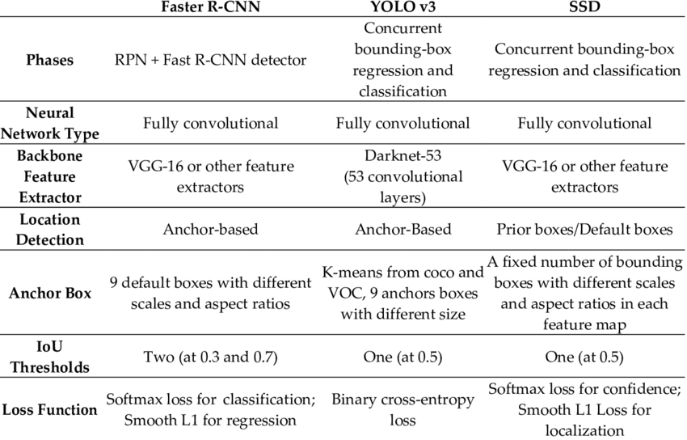
R-CNN Vs YOLO (You Only Look Once) vs SSD (Single Shot Multi-box Detection)

Slide 22
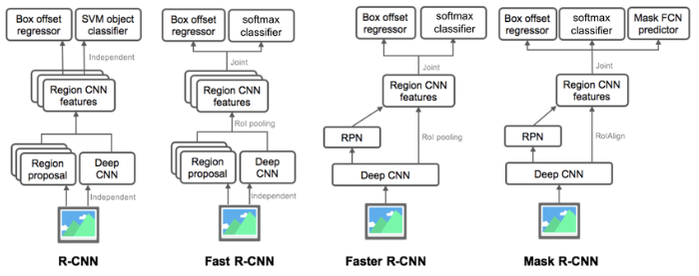
Variants of R-CNN

Slide 23
3D Convolutional Neural Networks

Slide 24
3D-CNN
CNNs designed to process three-dimensional data, such as volumetric images, video sequences, and medical scans
3D CNNs operate on 3D spatial data, capturing spatial hierarchies and temporal dynamics
Applications:
Medical imaging
Video analysis
Volumetric data analysis

Slide 25
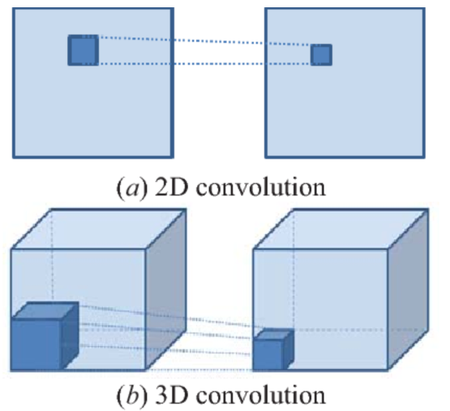
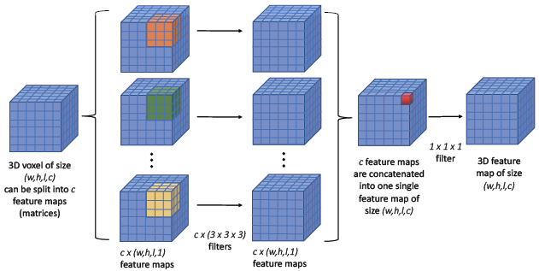
3D Convolution

Slide 26
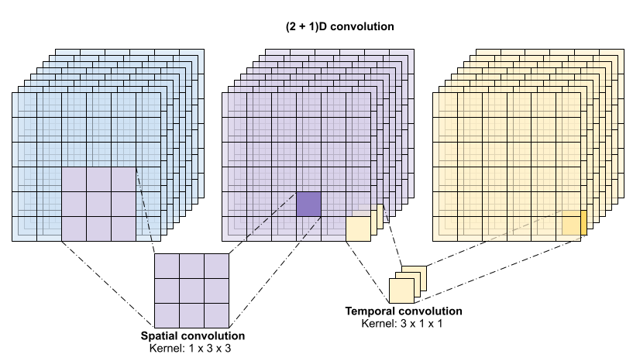
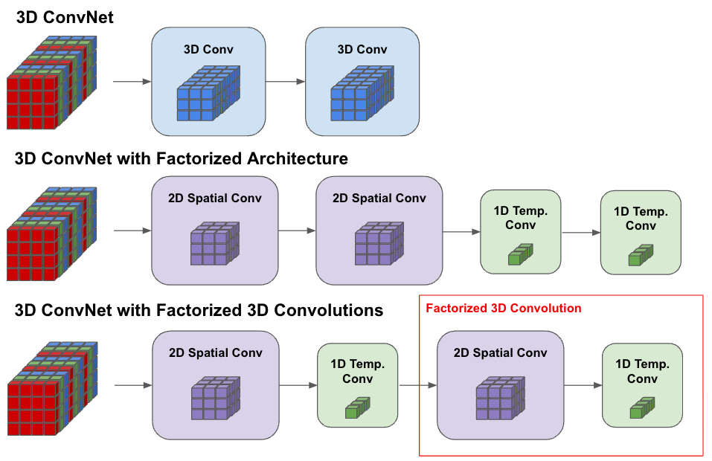
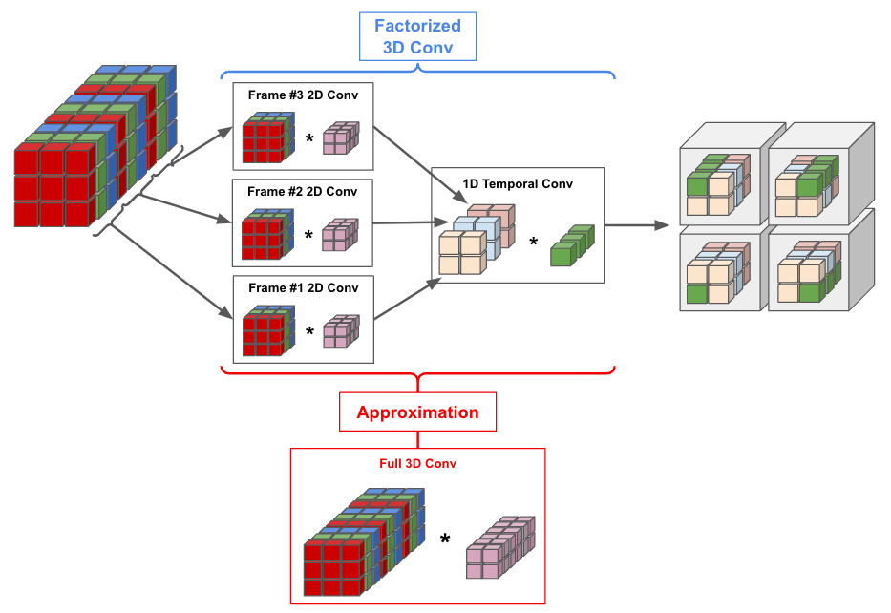
3D as 2D+1D Convolution

Slide 27
Applications of CNN
2D and 3D

Slide 28
Application areas of CNN
Image Classification (all types of simple CNNs)
Object Detection (U-Nets, ResNets, Encoder-Decoder networks, R-CNN, YOLO, etc.)
Image Segmentation (U-Nets, Encoder-Decoder networks, R-CNN, YOLO, etc.)
Facial Recognition (all types of CNNs)
Autonomous Vehicle Control
Medical Imaging
Video Analysis, etc.

